Slide 1
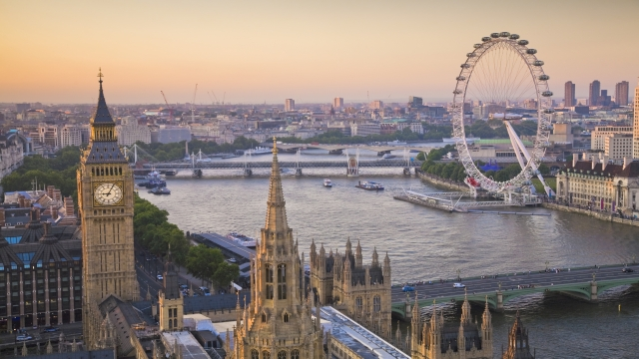
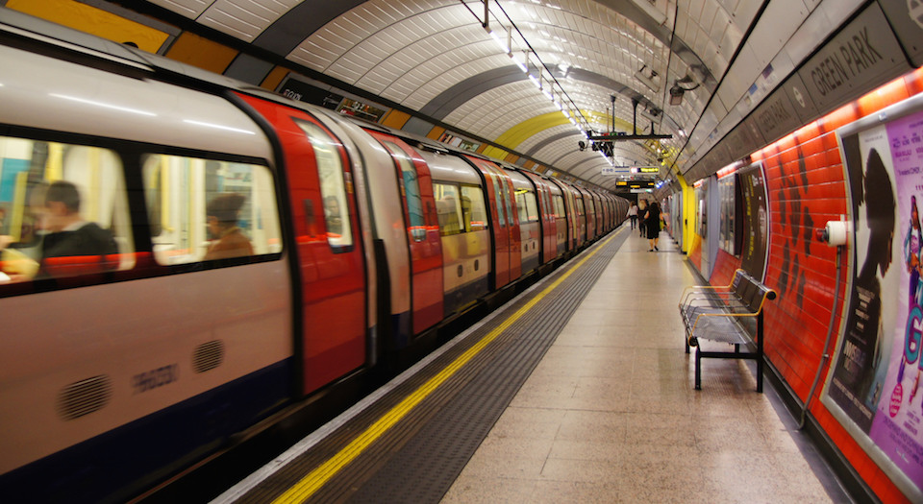
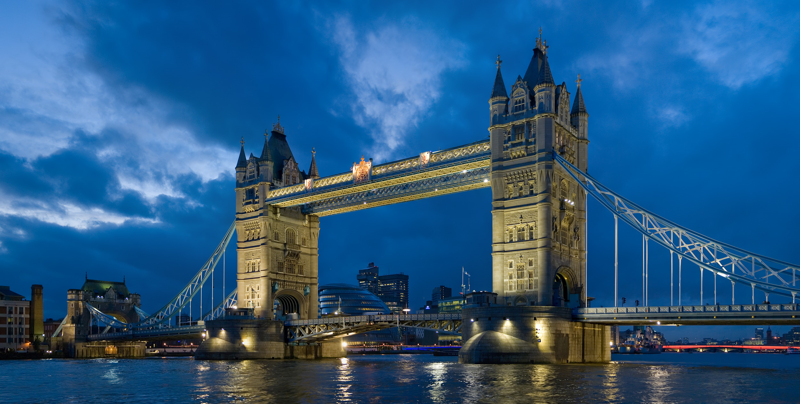
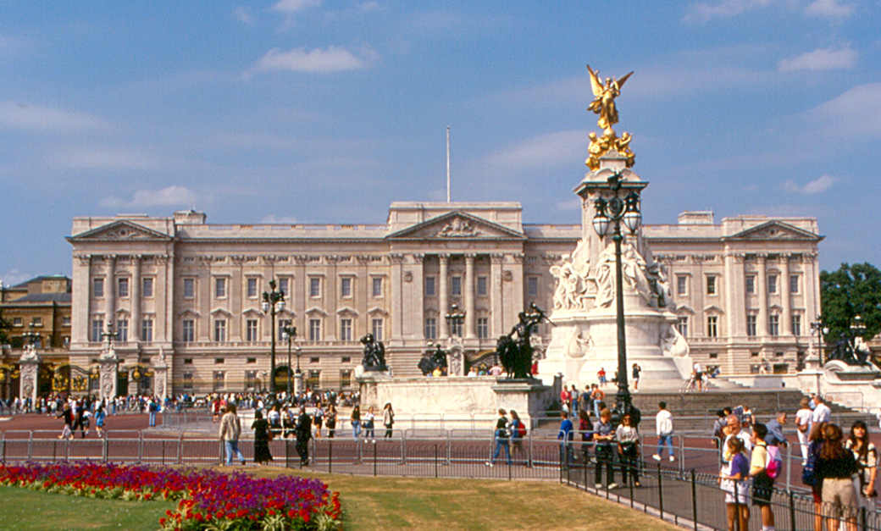
LONDON

Slide 2
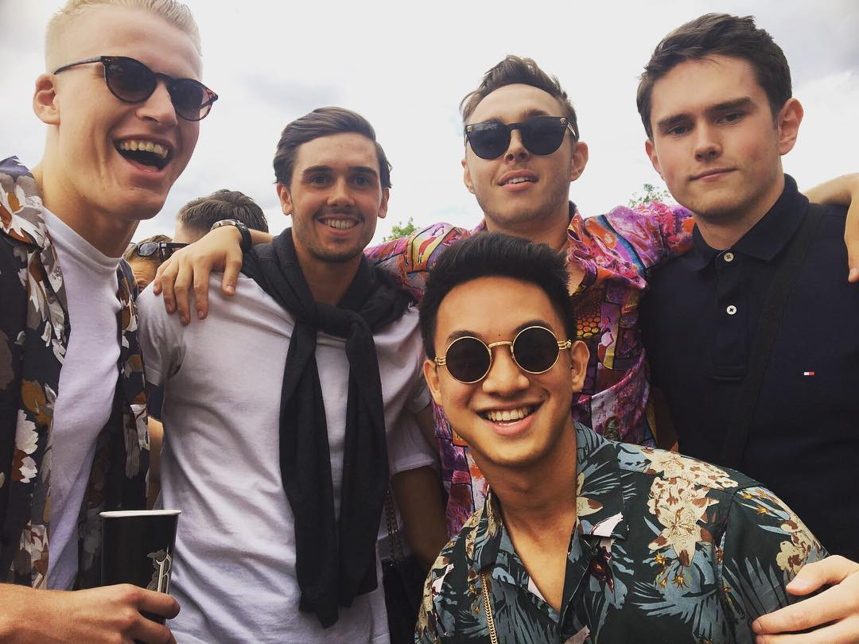
Me
My name is Justin Ng
I was born and raised in London
I am 20 years old
I study German and Marketing at the University of Warwick in England
Hobbies include going to the gym, tennis, going out with my friends, festivals

Slide 3
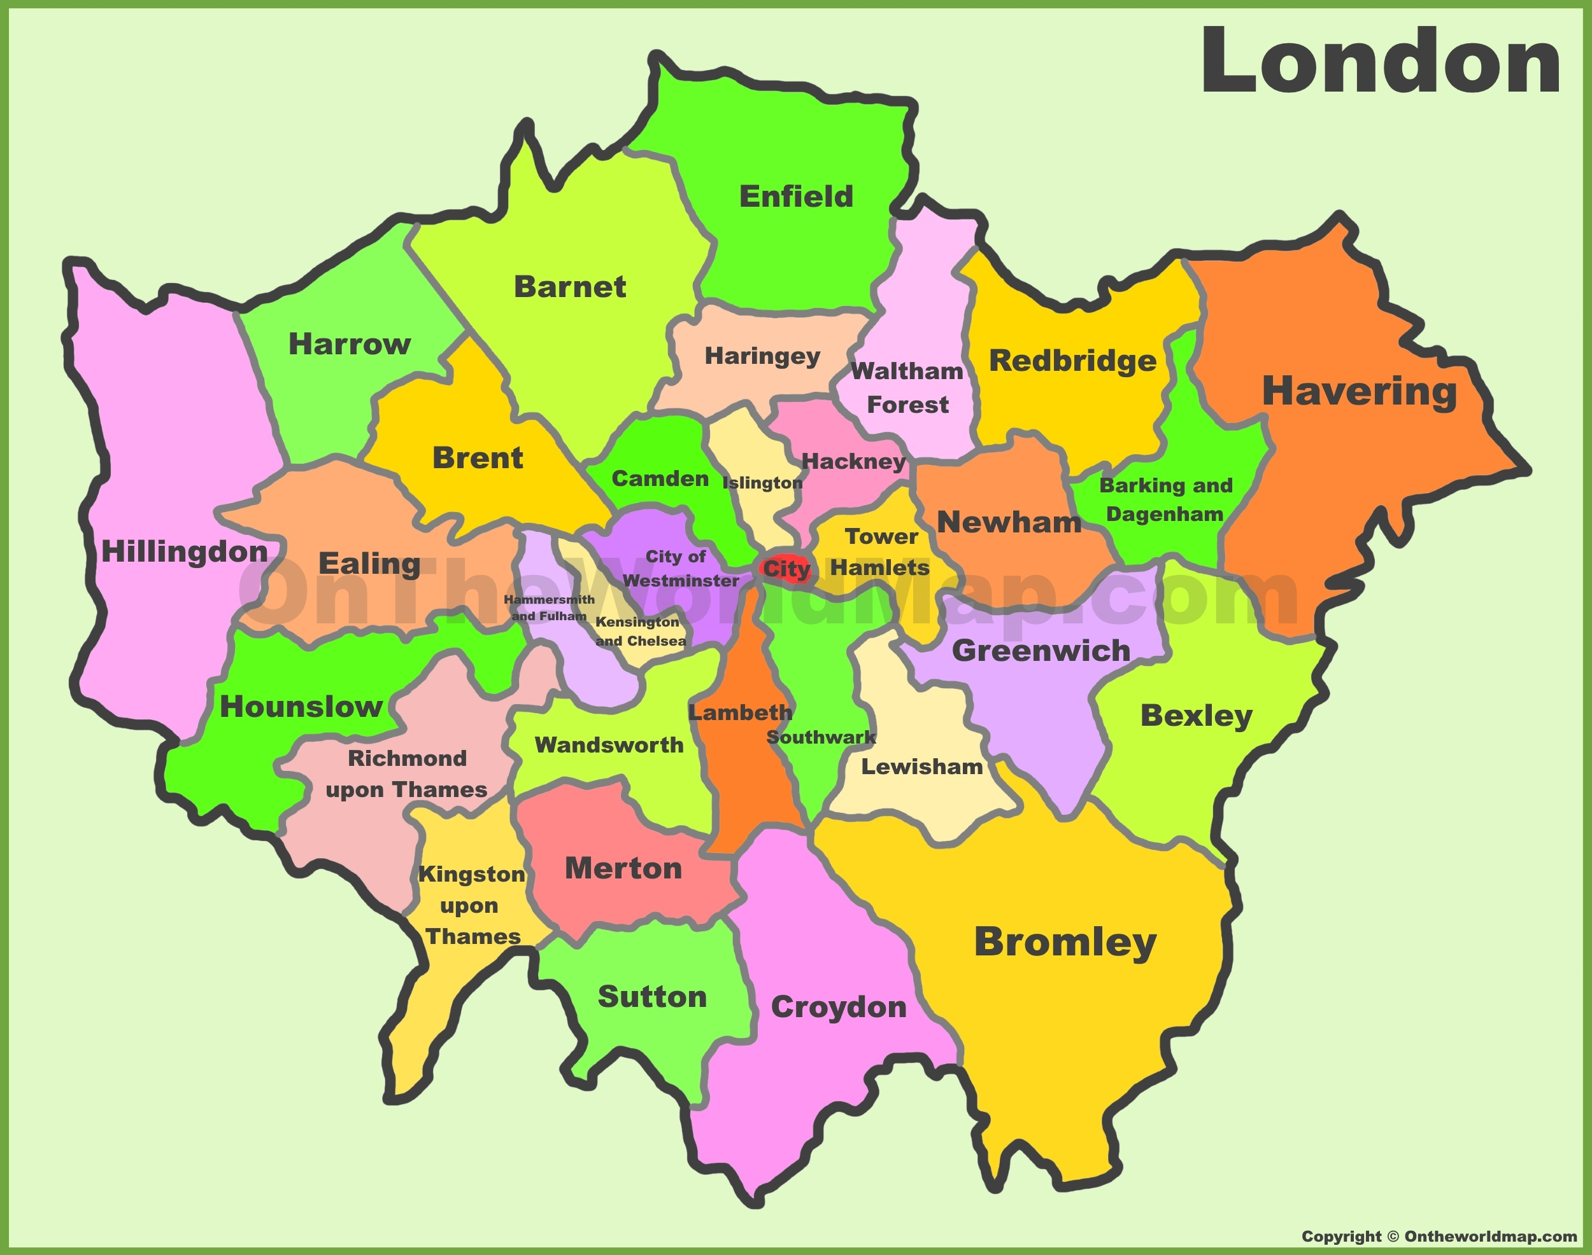
Facts
London is the capital city of England in the South-East of the country with a population of 14 million
32 Districts make up the city of London
The river Thames runs through the
middle of the city and is 215 miles long
London is the largest financial centre
The London Underground (tube) is
243 miles long making it the longest in
the world.

Slide 4
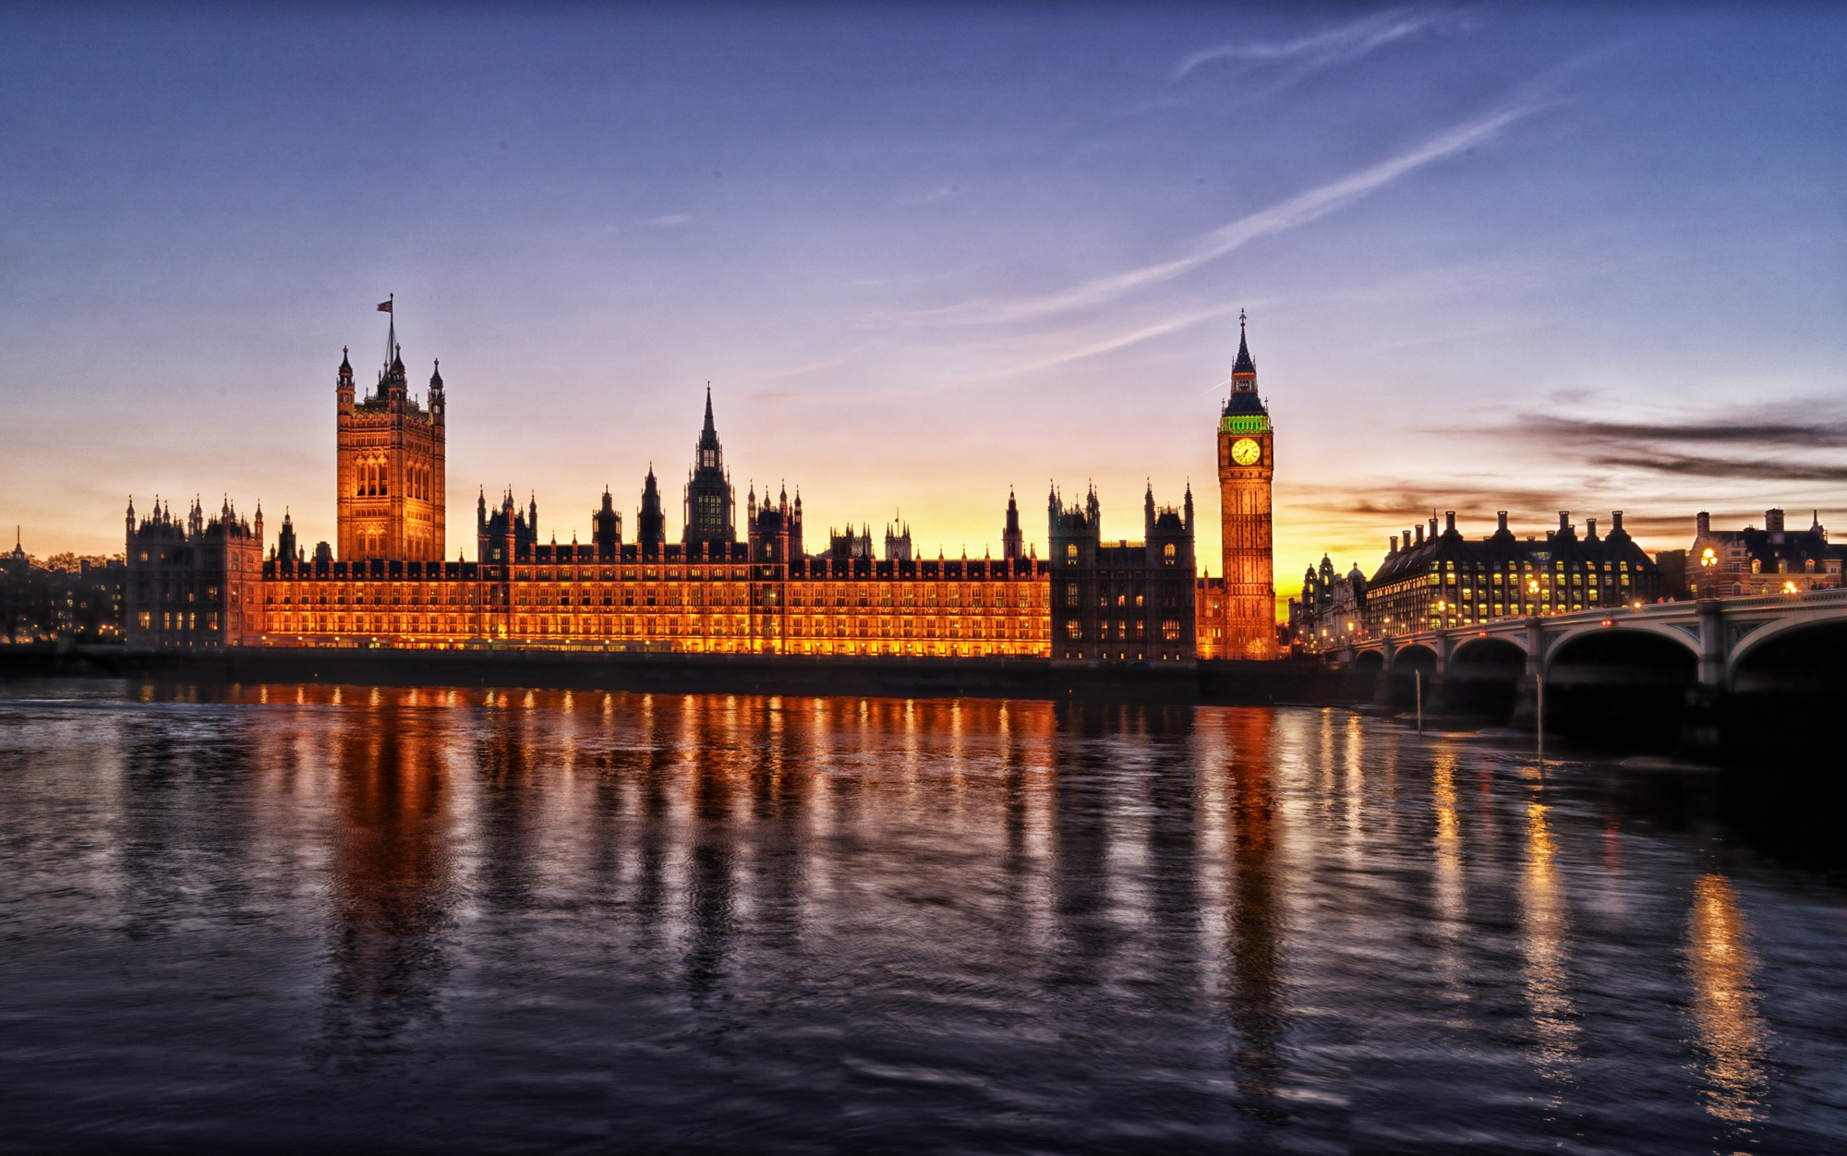
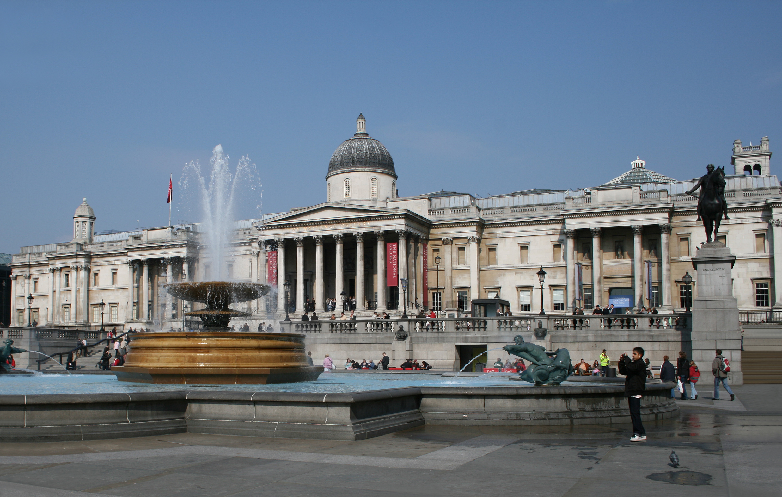
Famous landmarks
Big Ben
Houses of Parliament
Buckingham palace
Tower of London
London Eye
National gallery
Etc..

Slide 5
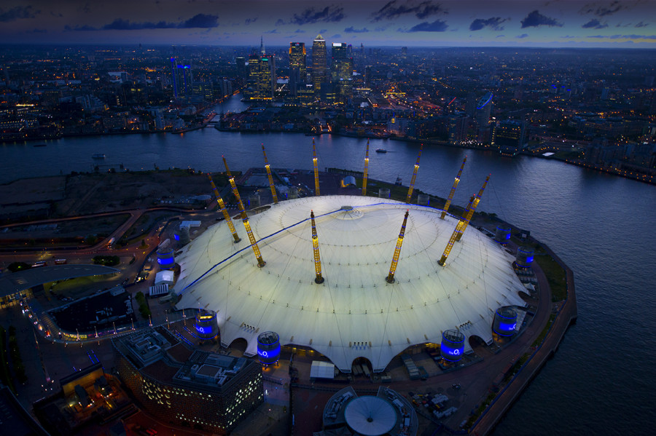
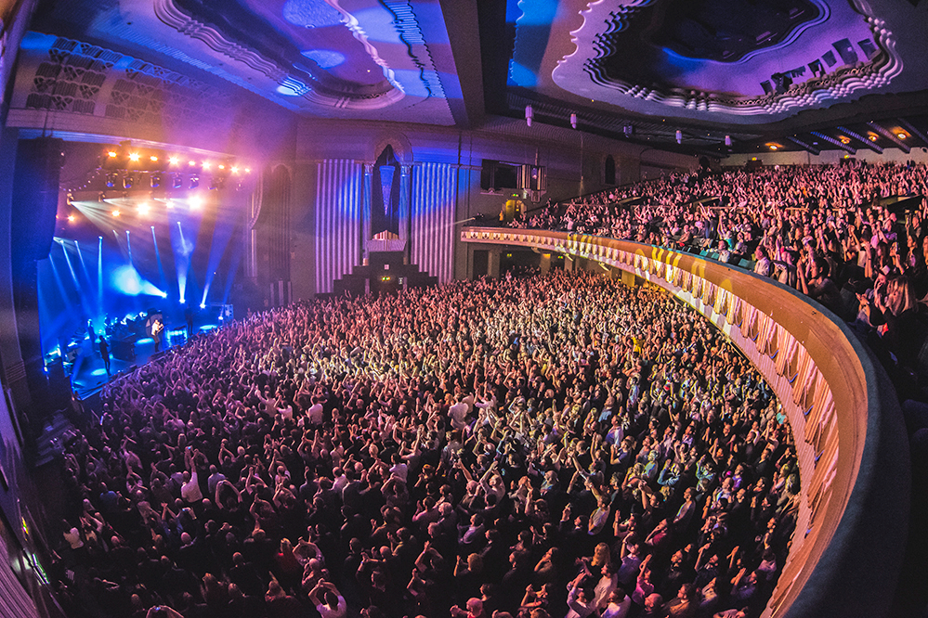
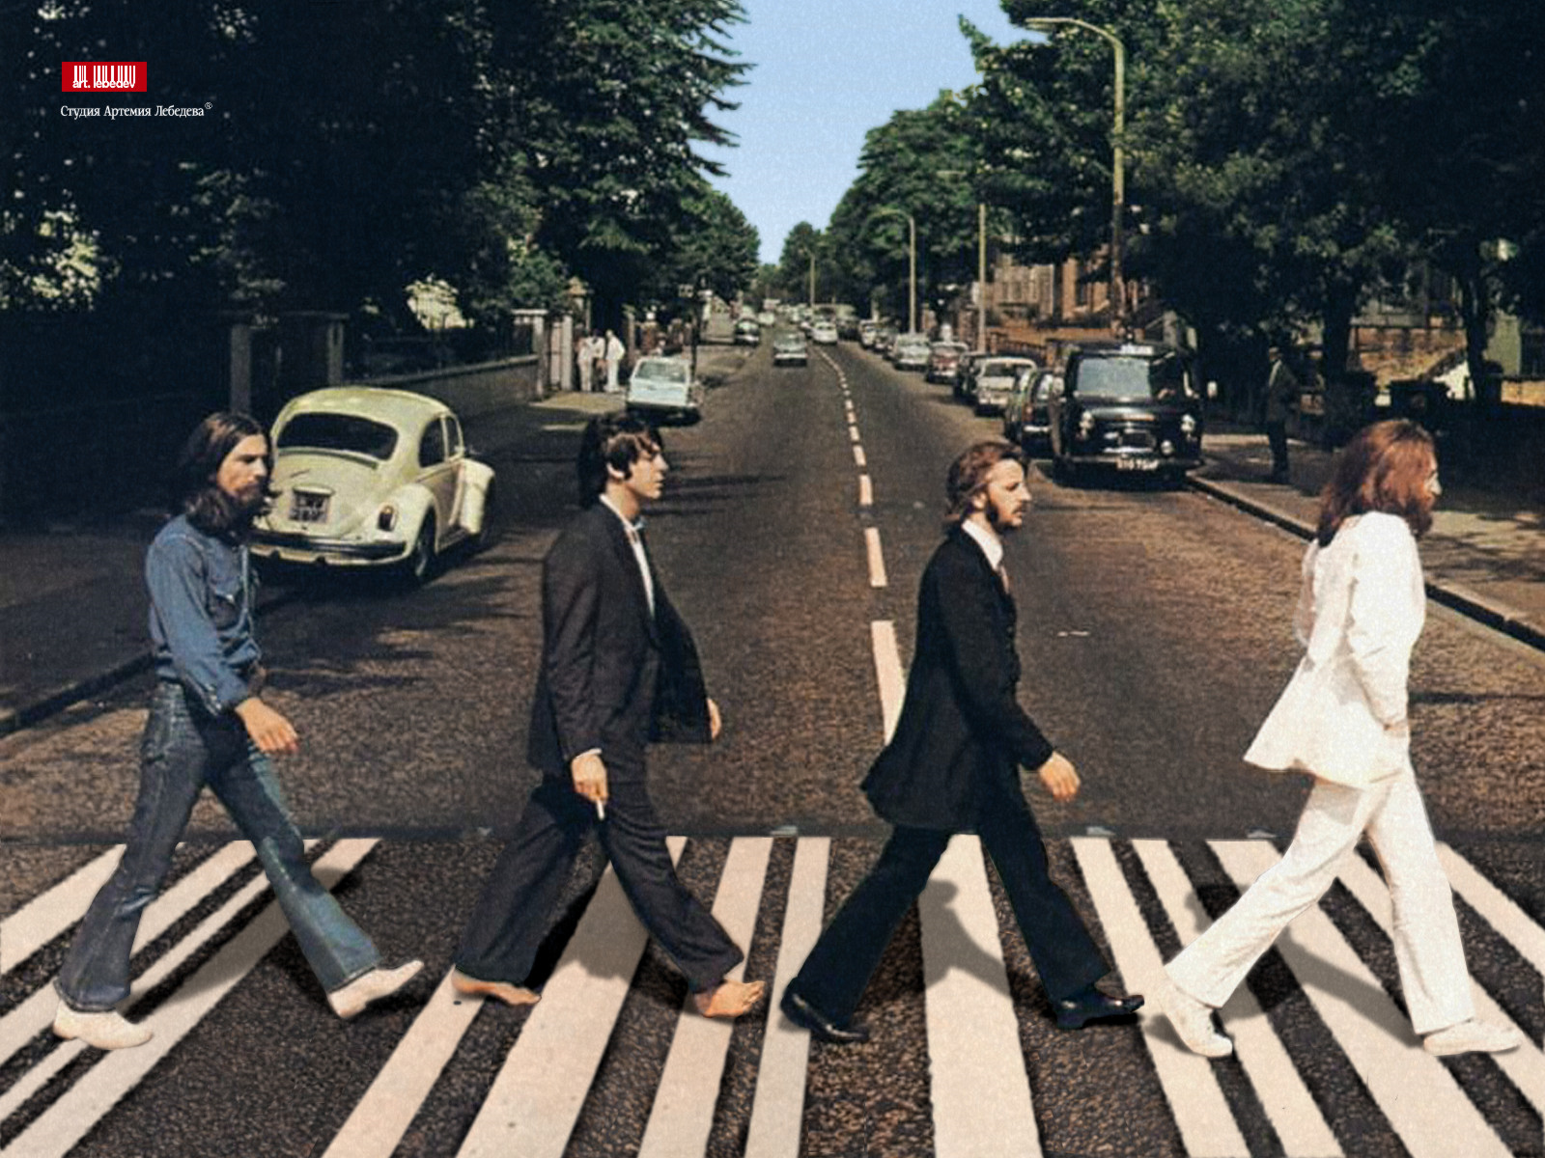
Music
O2 arena
Brixton academy
Hammersmith Apollo
David Bowie
The Beatles
Elton John

Slide 6
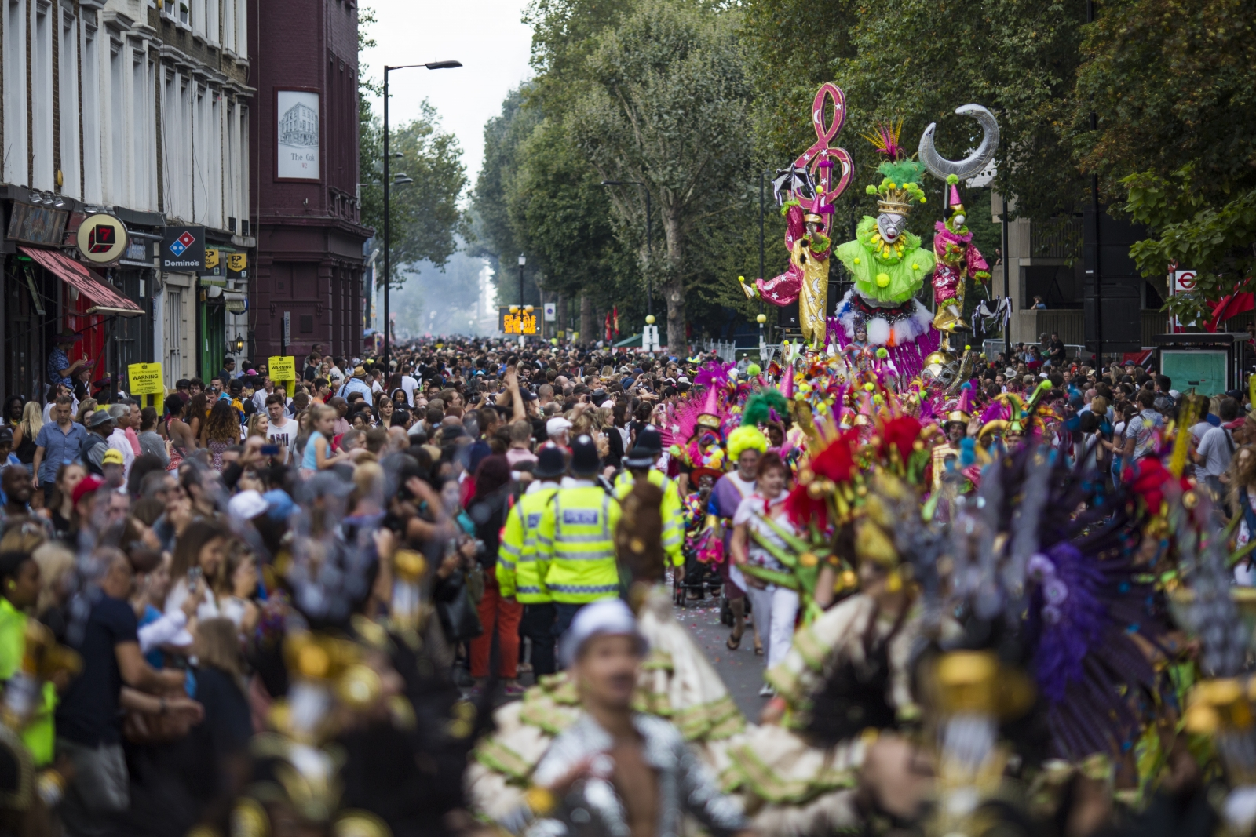
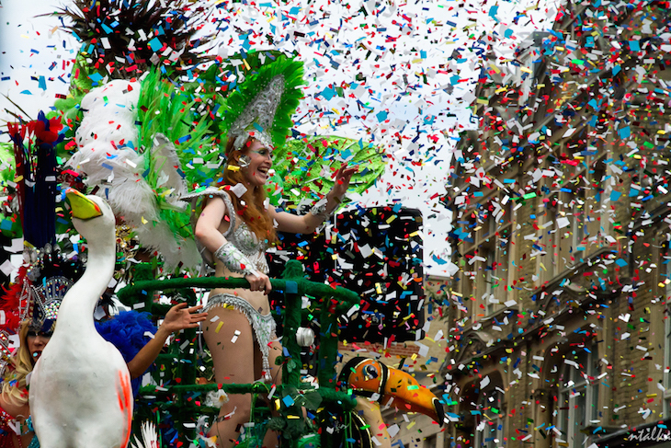
Festivals and culture
Most famous festival is the Notting hill Carnival which happens every year on August Bank Holiday and is the worlds second largest carnival.
Has a distinct Afro- Caribbean feeling including a 3 mile parade.

Slide 7
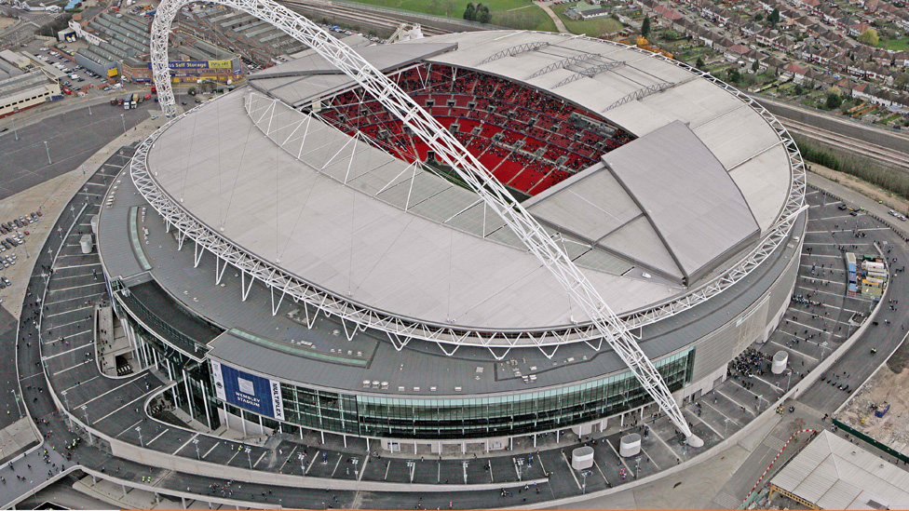
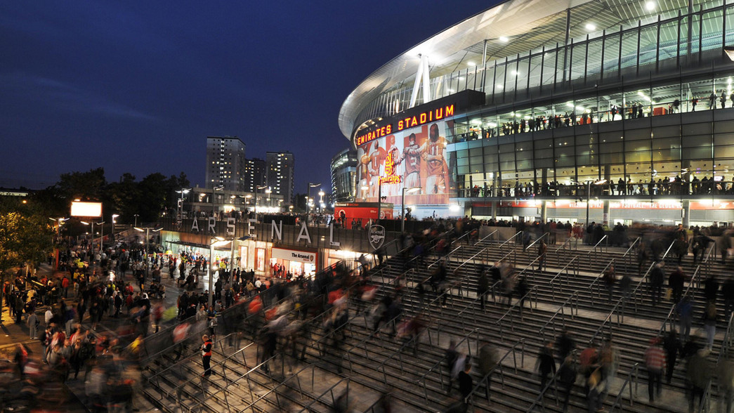
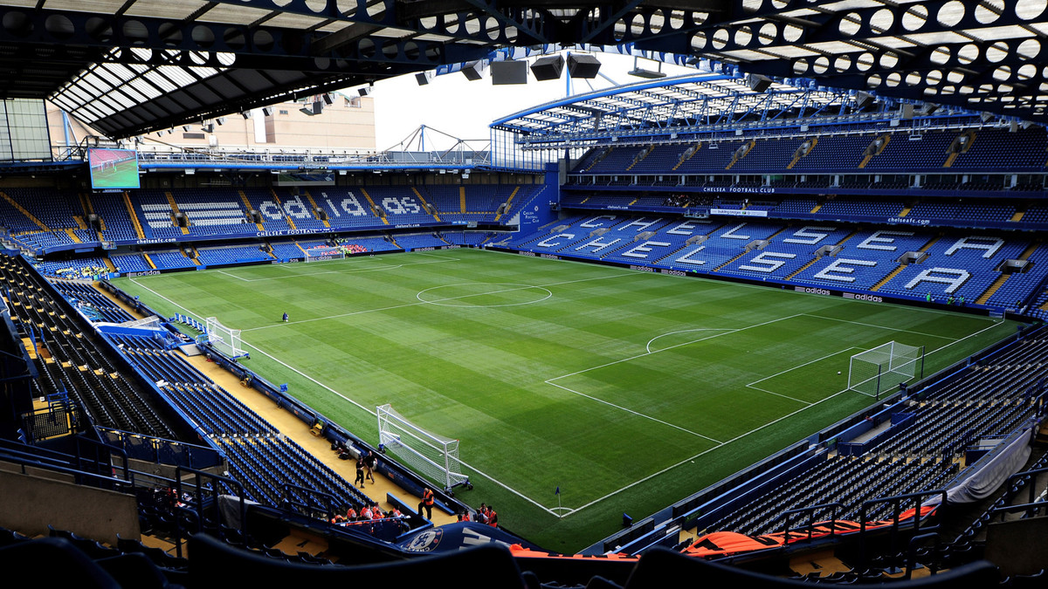
Sport
Wembley stadium
Emirates stadium- Arsenal
Stamford Bridge- Chelsea
White Hart Lane- Tottenham

